Slide 1

Advanced Database Systems
Introduction to Database Systems
And
History of Databases

Slide 2
Database Systems
A database is an organized collection of inter-related data that models some aspect of the real-world.
A database is an organized collection of structured information, or data, typically stored electronically in a computer system. A database is usually controlled by a database management system(DBMS).

Slide 3
Database Management System(DBMS)
DBMS serves as an interface between the database and its end users or programs, allowing users to retrieve, update, and manage how the information is organized and optimized.-www.oracle.com
DBMS is the software that manages a database.

Slide 4
Data File and File Processing
Data is stored as comma-separated value (CSV) file or any data file structures. Each entity will be stored in its own file. The application has to parse files each time it wants to read or update records.
Sequential File
Random File
Index Sequential File

Slide 5
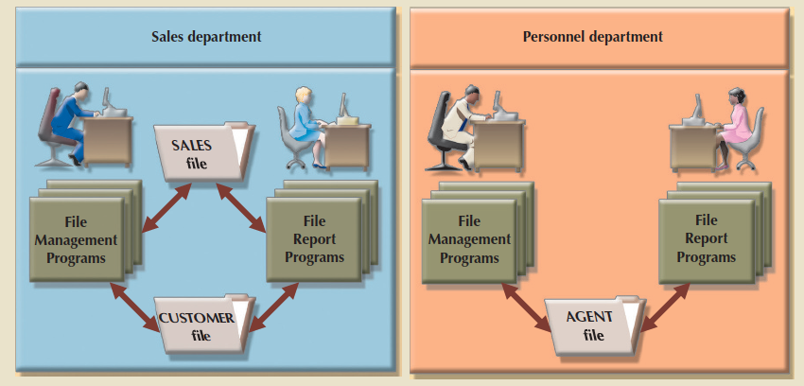
Data File and File Processing

Slide 6
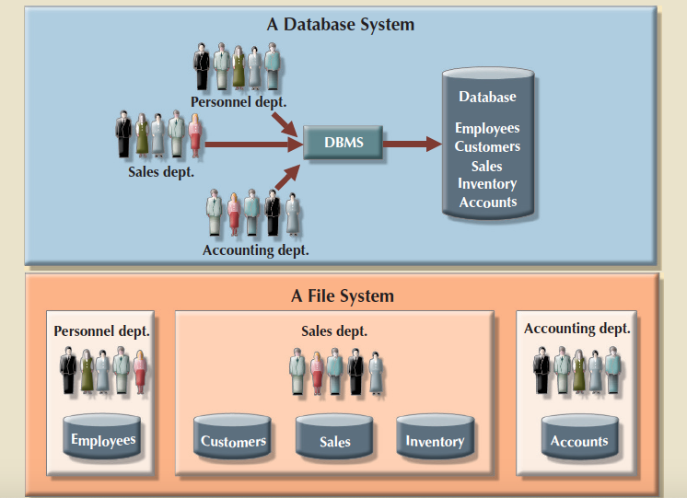
File Processing Vs. Database System

Slide 7
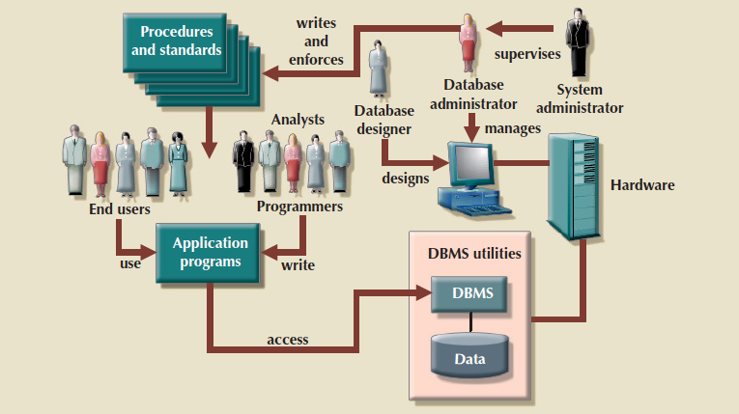
Database System Environment

Slide 8
History of Databases
Hot Topic Debate in Databases
SQL Vs. NoSQL (Today)
Relational Vs. CODASYL (1970)
CODASYL: Conference/Committee on Data Systems Languages

Slide 9
History of Databases
1960s – IDS (Integrated Data Store)
Developed at GE
Network data model
One of the first DBMSs
1960s – CODASYL
Formed in 1959 by COBOL Programmer
Leaded by Charles Bachman

Slide 10
History of Databases
C_ID | C_NAME | C_CITY | C_STATE
001 | John Bars | Tampa | FL
005 | Tom Smith | New York | NY
P_ID | P_NAME | P_SIZE
100 | COPY Paper | Large
PARENT | CHILD
PARENT | CHILD
B_QTY | B_PRICE
10 | 50
5 | 25
Network Data Model

Slide 11
History of Databases
1960s – IMS (Information Management System)
Developed by IBM
Hierachical data model
Defined Physical Data Storage

Slide 12
History of Databases
C_ID | C_NAME | C_CITY | C_STATE | PTR
001 | John Bars | Tampa | FL
005 | Tom Smith | New York | NY
P_ID | P_NAME | P_SIZE | B_QTY | B_PRICE
100 | COPY Paper | Large | 5 | 25
P_ID | P_NAME | P_SIZE | B_QTY | B_PRICE
100 | COPY Paper | Large | 10 | 50
Hierarchical Data Model

Slide 13
History of Databases
1970s – Relational Data Model
Invented by Ted Codd
Table Based Data Model
Database Abstraction
Paper: A Relational Model of Data for Large Shared Data Banks by E. F. Codd

Slide 14
History of Databases
C_ID | C_NAME | C_CITY | C_STATE
001 | John Bars | Tampa | FL
005 | Tom Smith | New York | NY
P_ID | P_NAME | P_SIZE
100 | COPY Paper | Large
B_ID | B_QTY | B_PRICE | C_ID | P_ID
1001 | 10 | 50 | 001 | 100
1002 | 5 | 25 | 005 | 100
Relational Data Model

Slide 15
History of Databases
1980s – Relational Data Model
Early Relational DBMSs : System R, INGRES, Oracle
IBM lauched DB2 in 1983
"SEQUEL" became standard SQL
1980s – Object Oriented Data Model
Tightly coupling objects and database
Object Oriented DBMSs : Versant, Object Store,
Mark Logic

Slide 16
History of Databases
Customer
class Customer { int C_ID, String C_NAME, String C_CITY, String C_STATE, String PHONE [] }
Phone
{ C_ID : "001", C_NAME : "John Bars", C_CITY : "Tampa", C_STATE: "FL", PHONE: [ "234-0933" , "425-0988" ] }
Object-Oriented Data Model

Slide 17
History of Databases
1990s – No major advancements in Database Systems
Microsoft introduced SQL Server
MySQL is a replacement of mSQL
Postgres gets SQL Supports
SQLite originated in early 2000s.
2000s – Data Warehouse and OLAP Database
Star and Snow Flask Models
DBMSs: Greenplum, Praccel, MonetDB, etc.

Slide 18
History of Databases
2000s – NoSQL Database Models
Non-relational Data Models
High-Availability & High-Scalability
DBMSs: MongoDB, Redis, Cassandra, Neo4J, DynamoDB,
HBASE, etc.
2010s – New SQL
OLTP performed same as NoSQL
DBMSs: Google Spanner, MEMSQL, H-Store, VOLT DB, etc.

Slide 19
History of Databases
2010s – Hybrid Systems
HTAP (Hybrid Transactional-Analytical Processing)
Execute OLTP and Complex OLAP
DBMSs: MEMSQL, Hyper, SAP/HANA, etc.
2010s – Cloud Systems
Database-as-a-service (DBaaS)
DBMSs: Google Spanner, Snowflake, Aurora, DynamoDB, etc.

Slide 20
History of Databases
2010s – Shared-Disk Engines
Distributed Database Models
Data Lake
DBMSs: Spark, Snowflake, RedShift, etc.
2010s – Graph Systems
DBMSs: Dgraph, Neo4J, MEMGraph, Apache GIRAPH, etc.
2010s – Time Series Systems
DBMSs: M3, TIMESCALE, influxDB, etc.
2010s – Specialized Systems

